Slide 1
Protecting User Password Keys at Rest (on the Disk)
Shiva Sankar, Thiruvenkadakrishnan S, Tharani M

Slide 2
Problem Statement
Developing an application for file encryption which is in turn protected by user pass phrase
Encrypt [AES-256] a user chosen file or directory using a random key a.k.a File Encryption Key.
Store the random key in a file, which has to be protected via user passphrase.
The user pass phrase as well as the random key cannot be stored in plain form in the text file.
If the user passphrase authentication is successful retrieve i.e., decrypt the file using File Encryption Key.

Slide 3
Unique Idea Brief (Solution)
FEK or File encryption key is used to encrypt files and folders.
FEK is encrypted using passphrase and store in .key file.
.key file is stored in a hidden folder
Folders are converted to archives and then encrypted.
Our solution uses AES 256 Bit Encryption.
It also uses a initialization vector or IV for encryption

Slide 4
Features Offered
It has AES - 256 Encryption
The File Encryption Keys randomly generated are stored in a hidden folder
It also uses a initialization vector
It can encrypt both files and entire folders

Slide 5
Process Flow
Initialize AES key and IV(Initialization vector) size.
Get inputs from user as to Encrypt or Decrypt and passphrase
Call the encrypt_file_or_directory function if input is encrypt
Call the decrypt_file_or_directory function if input is decrypt
If any other input is specified, print “Invalid Choice”.

Slide 6
Encryption Process Flow
If File is a folder, then compress it to a archive.
Generate a random AES file encryption key (FEK)
Encrypt file data using AES-256.
Encrypt the AES key using the RSA public key
Save encrypted file data in .enc file
Save the encrypted AES key in .key file in a hidden folder.

Slide 7
Decryption Process Flow
Read the encrypted file data in .enc file
Read the encrypted file data in .key file
Decrypt the file encryption key using the passphrase
Use the decrypted key to decrypt the contents of .enc file
If file type is folder, write the data to an archive and unzip the archive to a folder.
If file type is not folder, write the contents to the appropriate file.

Slide 8
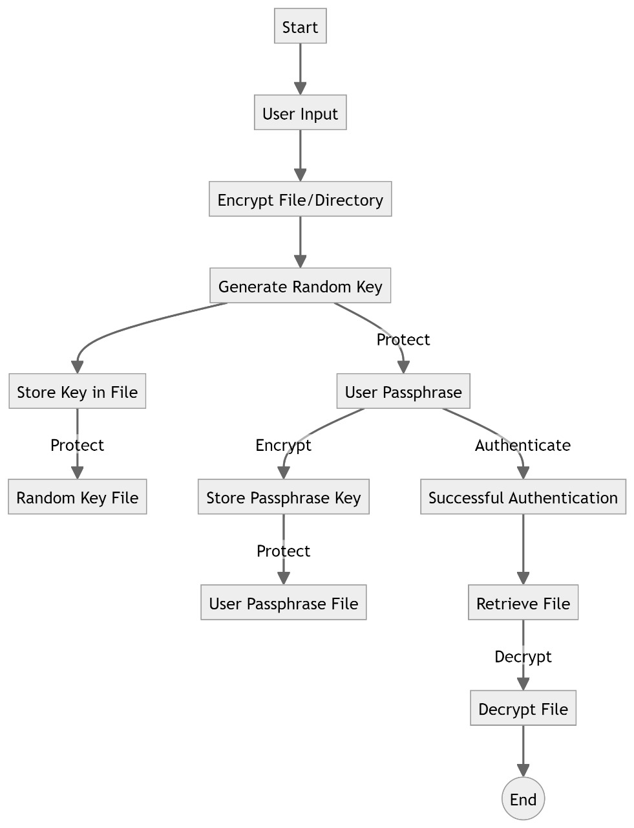
Architecture Diagram

Slide 9
Technologies used
Python
Kali Linux
Cryptography, OS libraries in python
Oracle VM VirtualBox

Slide 10
Team members and contribution:
SHIVA SANKAR
Developed the python program to encrypt/decrypt files
Created the flow of the program
Create the GitHub repository and contents for the powerpoint
THIRUVENKADAKRISHNAN S
Implemented folder encryption support by converting folder to archive files
Design the architecture diagram of the application.
Help implement ideas about how to develop the application.
THARANI.M
Helped in developing the application for encryption and decryption
Created the documentation for the application.
Did some PPT slides to explain about the application.

Slide 11
Conclusion
The application can successfully encrypt and decrypt files and folders with AES Encryption. Folder can be converted to an archive file and then encrypted just like how a normal file is encrypted.
The python program can be used to provide security to files and folders in operating systems such as Linux.

